Slide 1

Lecture 3
Sorting Algorithms and exercise

Slide 2
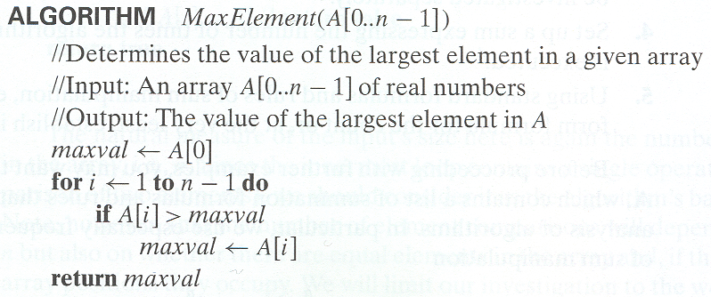
Example 1: Maximum element

Slide 3
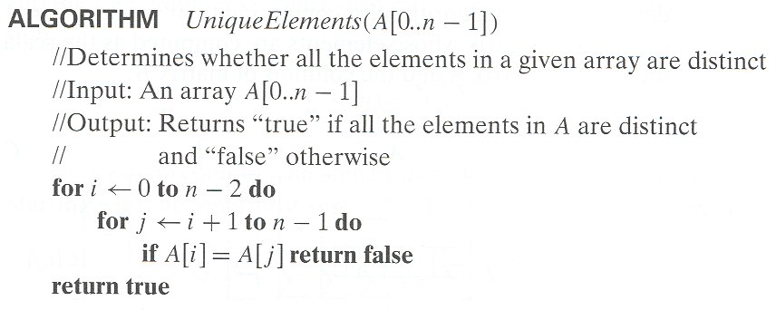
Example 2: Element uniqueness problem

Slide 4
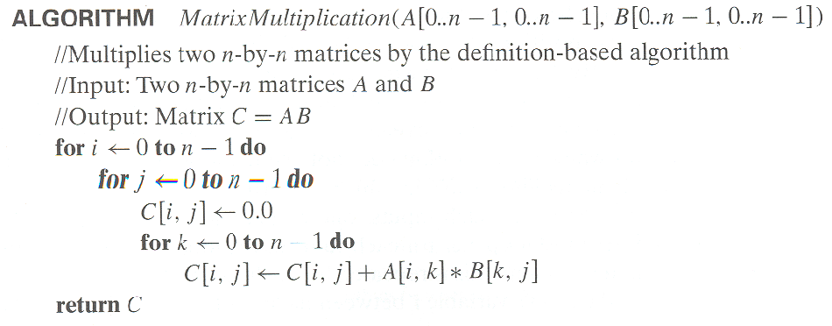
Example 3: Matrix multiplication

Slide 5
Example 4: Gaussian elimination
Algorithm GaussianElimination(A[0..n-1,0..n])
//Implements Gaussian elimination of an n-by-(n+1) matrix A
for i ← 0 to n - 2 do for j ← i + 1 to n - 1 do for k ← i to n do
A[j,k] ← A[j,k] - A[i,k] ∗ A[j,i] / A[i,i]
Find the efficiency class and a constant factor improvement.

Slide 6
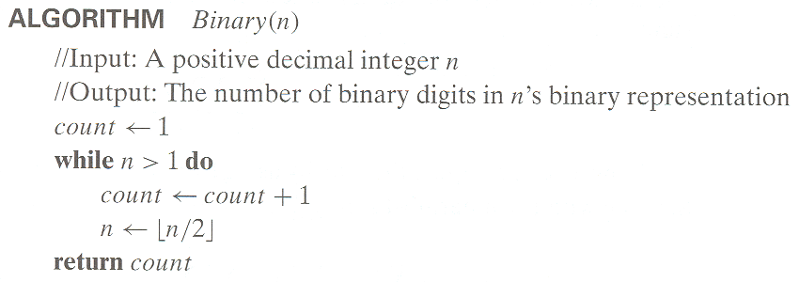
Example 5: Counting binary digits
It cannot be investigated the way the previous examples are.

Slide 7
Insertion Sort
The general idea of the insertion sort method is that for each element, find the slot where it belongs.
This sorting algorithm is frequently used when N is small.
Suppose A is an array with N elements.
The insertion sort scans A from A[1] to A[N] inserting each element A[k] into its proper position
Notes:
If list is Linked List Ѳ(n) worst-case time to find the right portion
If list is Array Ѳ(n) worst-case time to shift higher items over

Slide 8
Insertion Sort
The operation in each pass is as follows:
A[1 ] by itself is sorted.
A[2] is inserted either before A[1] or after A[1] so that A[1] and A[2] are sorted.
A[N] is inserted into its proper place in A[1],A[2]…A[N-1] so that A[1],A[2]…A[N] is sorted.
Notes:
Insertion sort takes advantage of presorting.
It requires fewer comparisons than bubble-sort, unless the lit is backward.
It only requires one comparison per element for a presorted list.

Slide 9
Example
Suppose the following numbers are stored in an array A:
77,33,44,11,88,22,66,55
Pass 1:77,33,44,11,88,22,66,55
Pass 2:77,33,44,11,88,22,66,55
Pass 3:33,77,44,11,88,22,66,55
Pass 4:33,44,77,11,88,22,66,55
Pass 5:11,33,44,77,88,22,66,55
Pass 6:11,22,33,44,77,88,66,55
Pass 7:11,22,33,44,66,77,88,55
Pass 8:11,22,33,44,55,66,77,88
Notes:
Example: 24,13,9,64,7,23,34,47

Slide 10
Insertion Sort Algorithm
Insertion sort (A)
{
for (i=1;i<n;i++)
{
key=A[i]
j=i-1;
while (j>0 && A[j]>key)
{
A[j+1]=A[j];
j--;
}
A[j+1]=key;
}
}

Slide 11
Bubble Sort
The general idea of the bubble sort is that each element is compared to all the elements in the data.
The bubble sort algorithm requires N-1 passes to sort N items of data.
The bubble sort is notoriously slow, but it is conceptually the simplest of the sorting algorithms.
The result of the first pass is that the largest item is in the last location of the array.
The result of the second pass is that the second largest item is in the second last location of the array.
etc.
After N passes, the entire array is sorted.

Slide 12
Bubble Sort
The operation in each pass is as follows:
First, the values in the first two locations are compared. If necessary the values are exchanged, so that the largest one is last.
Then, the values in the second and third locations are compared. If necessary the values are exchanged, so that again the largest one is last.
This process repeats to the end of the array.
In effect, the largest item bubbles its way towards the top. It keeps on going until either it reaches the top and the pass ends.
If a complete pass is made without any exchanges being made, the data must already be sorted.

Slide 13
Example
Suppose the following numbers are stored in an array A:
32,51,27,85,66,23,13,57
Pass 1:
Compare A[1] and A[2]:Since 32<51 the list is not altered.
Compare A[2] and A[3]: Since 51>27 interchange 51 and 27.
32,27,51,85,66,23,13,57
Compare A[3] and A[4]:Since 51<85 the list is not altered.
Compare A[4] and A[5]: Since 85>66 interchange 85 and 66.
32,27,51,66,85,23,13,57
Compare A[5] and A[6]: Since 85>23 interchange 85 and 23.
32,27,51,66,23,85,13,57
Compare A[6] and A[7]: Since 85>13 interchange 85 and 13.
32,27,51,66,23,13,85,57
Compare A[7] and A[8]: Since 85>57 interchange 85 and 57.
32,27,51,66,23,13,57,85
Notes:
Example:5,9,2,7,1

Slide 14
Bubble Sort Algorithm
Bubble sort (A)
{
for (pass=1;pass<n;pass++)
for (c=1;c<=(n-pass);c++)
if (A[c]>A[c+1])
{
swap (A[c], A[c+1])
}
}

Slide 15
Complexity of Bubble Sort
Worst Case:
The worst case occurs when we have to search through the entire array of data and the item does not appear in data. In this case the algorithm requires f(n) = n-1 comparisons.
Average Case:
The average number of comparisons required to find the location item is approximately equal to half number of elements in the array that is :
f(n) = (n-1)/2 comparisons.

Slide 16
Complexity of Bubble Sort
Time consuming operations
compares, swaps.
Compares
a for loop embedded inside a for loop
(n-1)+(n-2)+(n-3) …+1 , or O(n²)
Swaps
inside a conditional -> #swaps data dependent !!
Best Case 0, or O(1)
Worst Case (n-1)+(n-2)+(n-3) …+1 , or O(n²)
Average Case O(n²)
Space
size of the array
an in-place algorithm
Notes:
We make (n-1) comparisons during the first pass, the next time we make (n-2)passes so we get
C=(n-1)+(n-2)+…..+1
C=n(n-1)/2
C=n²/2-n/2
C=O(n²)

Slide 17
Selection Sort
The general idea of the selection sort is that for each slot, find the element that belongs there.
The selection sort improves on the bubble sort by reducing the number of swaps.
The number of comparisons remains the same that is to sort N items you make N-1 passes through them.

Slide 18
Selection Sort
The operation in each pass is as follows:
First find the smallest element in the list and swap it with the element in the first position.
On the second pass you scan through just the first N-1 entries. Then find the second smallest element in the list and swap it in the element in the second position.
This process is repeated, with one item being placed in its correct location each time.
After N-1 passes, the entire collection of data is sorted.

Slide 19
Example
Suppose the following numbers are stored in an array A:
77,33,44,11,88,22,66,55
Pass 1: 77,33,44,11,88,22,66,55
Pass 2: 11,33,44,77,88,22,66,55
Pass 3: 11,22,44,77,88,33,66,55
Pass 4: 11,22,33,77,88,44,66,55
Pass 5: 11,22,33,44,88,77,66,55
Pass 6: 11,22,33,44,55,77,66,88
Pass 7: 11,22,33,44,55,66,77,88

Slide 20
Selection Sort Algorithm
Selection sort (A)
{
for (i=1;i<n;i++)
{
min=i;
for (j=i+1;j<n;j++)
{
if (A[j]<A[min])
min=j;
}
swap (A[min],A[i])
}
}

Slide 21
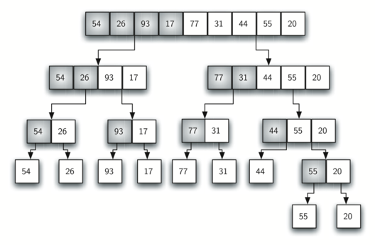
Mergesort
Mergesort (divide-and-conquer)
Divide array into two halves.

Slide 22
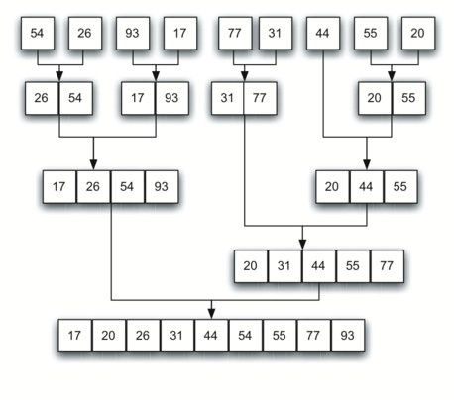
Mergesort
Mergesort (divide-and-conquer)
Divide array into two halves.
Recursively sort each half.
Merge two halves to make sorted whole.
Notes:
Merge Sort Example=9,2,6,5,3,10,1,7
2,9 5,6 3,10 1,7
2,5,6,9 1,3,7,10
1,2,3,5,6,7,9,10

Slide 23
Mergesort recursive
int MergeSort(int A[],int lb,int ub)
{
if lb > ub
return
int mid = (lb+ub)/2
mergeSort(A, lb, mid)
mergeSort(A, mid+1, ub)
merge(A, lb, ub, mid)
}

Slide 24
Merge Function
Merge(A, end1,end2)
{
i=0, j=end1,k=0
{
while i<end1 and j<end2
{ if(a[i]<A[j])
temp[k]=A[i]
i=i+1,k=K+1
else
temp[k]=A[j]
J=j+1, k=k+1 }
}
while i<end1
temp[k]=A[i]
i=i+1, k=k+1
while i<end2
temp[k]=A[i]
j=j+1, k=k+1
For(i=0;i<end2.i++)
A[i]=temp[i]
Notes:
The first line are the indices of the arrays I,j and k. the first while loop compares the two array I and j and places the smallest element in k .the next 2 while loop places the remaining highest elements in temp and the last for loop moves the elements from tem to the original array .

Slide 25
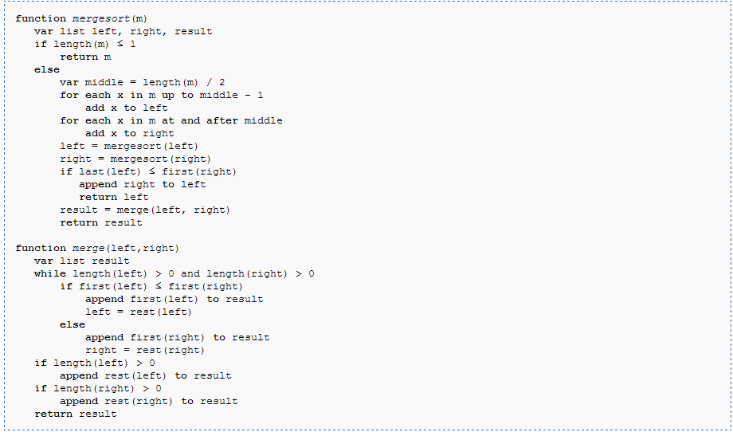

Slide 26
Sorting Algorithms
Quick Sort
The quick sort algorithm works by sub-dividing an array into two pieces and then calling itself recursively to sort the pieces
The following pseudo-code shows the algorithm at a high level:

Slide 27
Quick Sort
/* low --> Starting index, high --> Ending index */
quickSort(arr[], low, high)
{
if (low < high)
{
/* pi is partitioning index, arr[pi] is now
at right place */
pi = partition(arr, low, high);
quickSort(arr, low, pi - 1); // Before pi
quickSort(arr, pi + 1, high); // After pi
}
}
/* This function takes last element as pivot, places the pivot element at its correct position in sorted array, and places all smaller (smaller than pivot) to left of pivot and all greater elements to right of pivot */
partition (arr[], low, high)
{
// pivot (Element to be placed at right position)
pivot = arr[high];
i = (low - 1) // Index of smaller element
for (j = low; j <= high- 1; j++)
{
// If current element is smaller than the pivot
if (arr[j] < pivot)
{
i++; // increment index of smaller element
swap arr[i] and arr[j]
}
}
swap arr[i + 1] and arr[high])
return (i + 1)
}

Slide 28
More Sorting Algorithms
Counting Sort
Countingsort works if the values we are sorting are integers that lie in a relatively small range
For example, if we need to sort 1 million integers with values between 0 and 1,000, coutingsort can provide amazingly fast performance
The basic idea behind countingsort is to count the number of items in the array that have each value
Then it is relatively easy to copy each value, in order, the required number of times back into the array

Slide 29
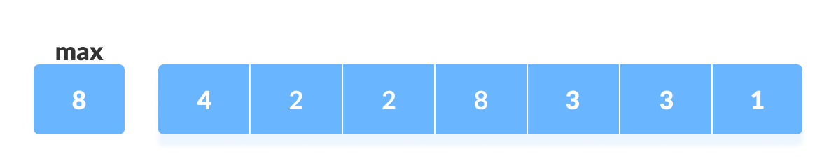
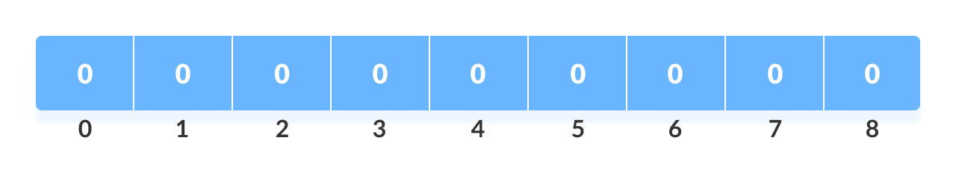
How Counting Sort Works?
Find out the maximum element (let it be max) from the given array.
Initialize an array of length max+1 with all elements 0. This array is used for storing the count of the elements in the array.

Slide 30
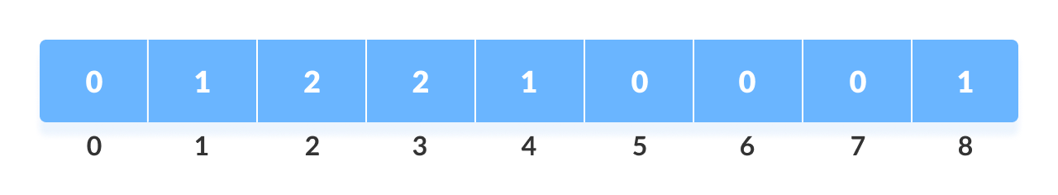
Store the count of each element at their respective index in count array
For example: if the count of element 3 is 2 then, 2 is stored in the 3rd position of count array. If element "5" is not present in the array, then 0 is stored in 5th position

Slide 31
Store cumulative sum of the elements of the count array. It helps in placing the elements into the correct index of the sorted array.

Slide 32
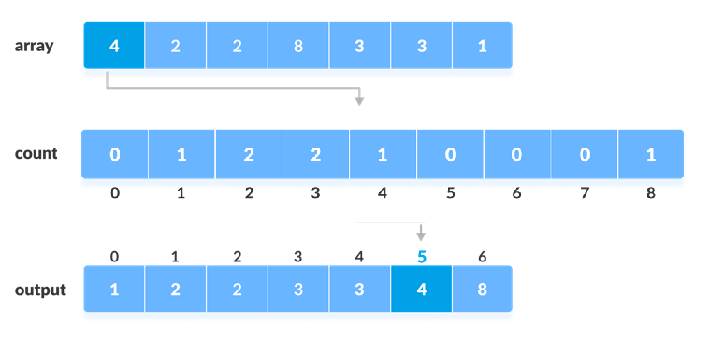
Find the index of each element of the original array in the count array. This gives the cumulative count. Place the element at the index calculated as shown in figure below.
After placing each element at its correct position, decrease its count by one.

Slide 33
More Sorting Algorithms
Counting Sort (contd.)
countingSort(array, size)
max <- find largest element in array
initialize count array with all zeros
for j <- 0 to size
find the total count of each unique element and
store the count at jth index in count array
for i <- 1 to max
find the cumulative sum and store it in count array itself
for j <- size down to 1
restore the elements to array
decrease count of each element restored by 1

Slide 34
More Sorting Algorithms
Counting Sort (contd.)
Let M be the number of items in the counts array (so M = max_value +1) and let N be the number of items in the values array, if your programming language doesn’t automatically initialize the counts array so that it contains 0s, the algorithm spends M steps initializing the array. It then takes N steps to count the values in the array
The algorithm finishes by copying the values back into the original array
Each value is copied once, so that part takes N steps. If any of the entries in the counts array is still 0, the program also spends some time skipping over that entry
In the worst-case, if all the values are the same, so that the counts array contains mostly 0s, it takes M steps to skip over the 0 entities
That makes the total runtime O(2 * N + M) = O(N+M)
If M is relatively small compared to N, this is much smaller than the O(N log N) performance given by other algorithms previously
In one test, quicksort(worst-case) took 4.29 seconds to sort 1 million items with values between 0 and 1,000, but it took countingsort only 0.03 seconds.
With Similar values, heapsort took roughtly 1.02 seconds

Slide 35
Bucket Sort
Bucket sort works by partitioning the elements into buckets and the return the result
Buckets are assigned based on each element’s search key
To return the result, concatenate each bucket and return as a single array

Slide 36
Bucket Sort
Some variations
Make enough buckets so that each will only hold one element, use a count for duplicates
Use fewer buckets and then sort the contents of each bucket
Radix sort (which I’ll demonstrate next)
The more buckets you use, the faster the algorithm will run but it uses more memory

Slide 37
Bucket Sort
Time complexity is reduced when the number of items per bucket is evenly distributed and as close to 1 per bucket as possible
Buckets require extra space, so we are trading increased space consumption for a lower time complexity
In fact Bucket Sort beats all other sorting routines in time complexity but can require a lot of space

Slide 38
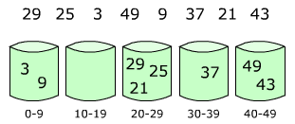
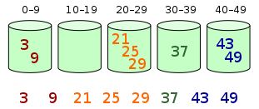
Bucket Sort
Multiple items per bucket:

Slide 39
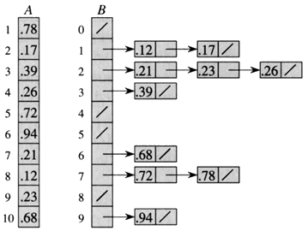
Bucket Sort
In array form:

Slide 40
Bucket Sort Algorithm
bucketSort()
create N buckets each of which can hold a range of values
for all the buckets
initialize each bucket with 0 values
for all the buckets
put elements into buckets matching the range
for all the buckets
sort elements in each bucket
gather elements from each bucket
end bucketSort

Slide 41
Bucket Sort Animation
https://www.cs.usfca.edu/~galles/visualization/BucketSort.html
Linked List array index= Value* #of Elements/(Max Value+1)

Slide 42
Bucket Sort Complexity
Worst Case Complexity: O(n2)
When there are elements of close range in the array, they are likely to be placed in the same bucket. This may result in some buckets having more number of elements than others.
It makes the complexity depend on the sorting algorithm used to sort the elements of the bucket.
The complexity becomes even worse when the elements are in reverse order. If insertion sort is used to sort elements of the bucket, then the time complexity becomes O(n2).
Best Case Complexity: O(n+k)
It occurs when the elements are uniformly distributed in the buckets with a nearly equal number of elements in each bucket.
The complexity becomes even better if the elements inside the buckets are already sorted.
If insertion sort is used to sort elements of a bucket then the overall complexity in the best case will be linear ie. O(n+k). O(n) is the complexity for making the buckets and O(k) is the complexity for sorting the elements of the bucket using algorithms having linear time complexity at the best case.
Average Case Complexity: O(n)
It occurs when the elements are distributed randomly in the array. Even if the elements are not distributed uniformly, bucket sort runs in linear time. It holds true until the sum of the squares of the bucket sizes is linear in the total number of elements.

Slide 43
Radix Sort
Improves on bucket sort by reducing the number of buckets
Maintains time complexity of O(n)
Radix sort executes a bucket sort for each significant digit in the data-set
100’s would require 3 bucket sorts
100000’s would require 6 bucket sorts

Slide 44

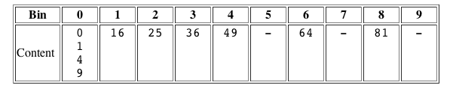
Radix Sort
Sort: 36 9 0 25 1 49 64 16 81 4
First Buckets:
Second Buckets:

Slide 45
Radix sort
Example:
2
0
5
1
7
3
4
6
0 1 0
0 0 0
1 0 1
0 0 1
1 1 1
0 1 1
1 0 0
1 1 0
0 1 0
0 0 0
1 0 0
1 1 0
1 0 1
0 0 1
1 1 1
0 1 1
0 0 0
1 0 0
1 0 1
0 0 1
0 1 0
1 1 0
1 1 1
0 1 1
0 0 0
0 0 1
0 1 0
0 1 1
1 0 0
1 0 1
1 1 0
1 1 1
0
1
2
3
4
5
6
7
Each sorting step must be stable.

Slide 46
Radix sort characteristics
Each sorting step can be performed via bucket sort, and is thus O(N).
If the numbers are all b bits long, then there are b sorting steps.
Hence, radix sort is O(bN).

Slide 47
What about non-binary?
Radix sort can be used for decimal numbers and alphanumeric strings.
0 3 2
2 2 4
0 1 6
0 1 5
0 3 1
1 6 9
1 2 3
2 5 2
0 3 1
0 3 2
2 5 2
1 2 3
2 2 4
0 1 5
0 1 6
1 6 9
0 1 5
0 1 6
1 2 3
2 2 4
0 3 1
0 3 2
2 5 2
1 6 9
0 1 5
0 1 6
0 3 1
0 3 2
1 2 3
1 6 9
2 2 4
2 5 2

Slide 48
Radix Sort Animation
http://www.cs.auckland.ac.nz/software/AlgAnim/radixsort.html

Slide 49
More Sorting Algorithms
Summary – Sorting Algorithms
Algorithm | Runtime | Techniques | Usefulness
Insertionsort | O(N²) | Insertion | Very small arrays
Selectionsort | O(N²) | Selection | Very small arrays
Bubblesort | O(N²) | Two-way passes, restricting bounds of interest | Very small arrays, mostly sorted arrays
Heapsort | O(N logN) | Heaps, storing complete trees in an array | Large arrays with unknown distribution
Quicksort | O(N logN) expected, O(N²) worst case | Divide-and-conquer, swapping items into position, randomization to avoid worst-case behaviour | Large arrays without too many duplicates, parallel sorting
Mergesort | O(N logN) | Divide-and-conquer, merging, external sorting | Large arrays with unknown distribution, parallel sorting
Coutingsort | O(N+M) | Counting | Large arrays of integers with a limited range of values
Bucketsort | O(N + M) | Buckets | Large arrays with reasonably uniform value distribution

